Slide 1
Smart Curriculum Activity & Attendance App
CSE7302- University Project
Review-1
Batch Number: CSE_144
Under the Supervision of,
Ms Smita S.P (Assistant Professor)
School of Computer Science and Engineering
Presidency University
Roll Number | Student Name
20221CSE0559 | Sharanegouda Malipatil
20221CSE0582 | Bhagesh
20221CSE0593 | Kotesh N B
Name of the Program: B. Tech (CSE)
Name of the HoD: Dr. Asif Mohammed
Name of the Program Project Coordinator: Mr. Sakthi S
Name of the School Project Coordinators: Dr. Sampath A K , Dr. Geetha A

Slide 2
Content
Problem Statement
Objectives
Background and Related work for title Selection
Innovation or Novel Contributions
Git-hub Link
Timeline of the Project
References

Slide 3
Problem Statement
Many educational institutions still rely on manual or basic digital attendance systems that consume class time and are prone to errors. Teachers spend valuable instructional time marking attendance instead of teaching. At the same time, students often misuse free periods due to the lack of structured academic or career guidance. Existing systems do not integrate attendance, timetable management, and personal planning. This creates inefficiency in administration and reduced student productivity. A smart, integrated solution is required to automate attendance and guide students toward productive use of their academic time.

Slide 4
Objectives
To develop a smart attendance and curriculum activity application for educational institutions.
To automate attendance using digital methods and reduce manual effort, errors, and time consumption for teachers.
To help students utilize free periods in a productive and goal-oriented manner.
To generate a structured daily routine based on timetable and student goals.
To improve student engagement, discipline, and time management by promoting organized and consistent academic habits.
To provide an easy-to-use, reliable system that can be efficiently used by both students and faculty members.

Slide 5
Background and Related work for title Selection
The use of digital tools in education has increased rapidly, especially for attendance and timetable management. However, most existing systems focus only on attendance recording and lack features that support student productivity during free hours. Studies show that structured planning and guided activities improve learning outcomes and personal development. Current solutions do not combine attendance automation with personalized activity suggestions. This highlights the need for a smart application that integrates attendance tracking with curriculum-based activity planning, leading to the selection of the title Smart Curriculum Activity & Attendance App.

Slide 6
Innovation or Novel Contributions
Integrated system combining attendance and activity planning
Automated attendance using smart technologies
Personalized activity suggestions during free periods
Daily routine generation based on timetable and goals
Minimal infrastructure requirement
Simple and user-friendly interface
Real-time attendance visibility for students and teachers
Improves student discipline and productive use of academic time

Slide 7
Github Link
The Github link provided should have public access permission.
https://github.com/Kotesh989/CSE_144-project

Slide 8
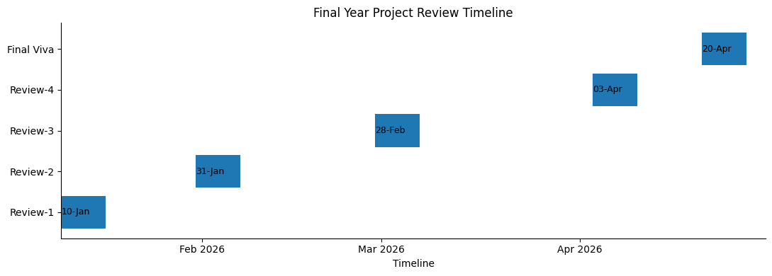
Timeline of the Project (Gantt Chart)
Smart Curriculum Activity & Attendance App
16-jan

Slide 9
References (IEEE Paper format)
A. Patel and R. Shah, “Design and Development of a Mobile-Based Attendance System,” International Journal of Computer Applications, vol. 174, no. 15, pp. 12–17, 2021.
S. Kumar and P. Verma, “A Study on Student Time Management Using Smart Applications,” Journal of Emerging Technologies and Innovative Research, vol. 7, no. 6, pp. 245–250, 2020.
J. Li, Y. L. Theng, and S. Foo, “Effect of Mobile Applications on Learning and Productivity,” Journal of Medical Internet Research, vol. 18, no. 8, e226, 2016.
Ministry of Education, Government of India, National Education Policy 2020, New Delhi, India.

Slide 10


